Slide 1
Automatic SIMDization

Slide 2
Vectorization and SIMDization
Vector supercomputers used for scientific computation
Since CDC6600 and Cray-1
A lot of effort in vectorizing Fortran DO-loop
Many scientific code do not have complex dependences in their innermost loops

Slide 3
What is vectorization
VF = 4
0
1
2
3
VR1
a
b
c
d
OP(a)
OP(b)
OP(c)
OP(d)
VR2
VOP( a, b, c, d )
VR1
VR3
Vector operation
VR4
vectorization
VR5
Vector Registers
Data elements packed into vectors
Vector length → Vectorization Factor (VF)
Data in Memory:
a
b
c
d
e
f
g
h
i
j
k
l
m
n
o
p

Slide 4
Vectorization
Vector section notation: a[i:j] is the vector composing of elements a[i], a[i+1], …, a[j]
original serial loop: for(i=0; i<N; i++) { a[i] = a[i] + b[i]; }
loop in vector notation: for (i=0; i<N; i+=VF) { a[i:i+VF] = a[i:i+VF] + b[i:i+VF]; }
loop in vector notation: for (i=0; i<(N-N%VF); i+=VF) { a[i:i+VF] = a[i:i+VF] + b[i:i+VF]; } for ( ; i < N; i++) { a[i] = a[i] + b[i]; }
vectorization
vectorized loop
epilog loop
Loop based vectorization
No dependences between iterations
Notes:
- Simultanuously operate on different elements
- Prepare data in Small vectors (pack data elements)

Slide 5
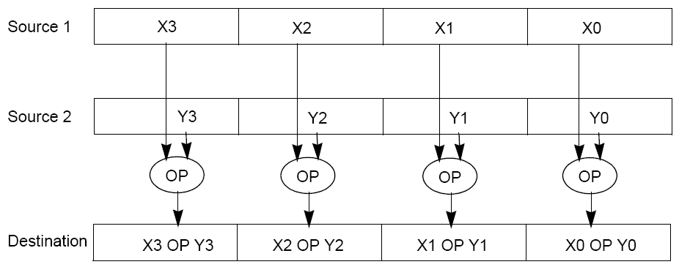
SIMD
SIMD (single instruction multiple data) architecture performs the same operation on multiple data elements in parallel

Slide 6
Intel SSE
SSE (Streaming SIMD Extension) was introduced with Pentium III
Intel’s response to AMD’s 3DNow!
Floating point support
70 new instructions

Slide 7
Intel SSE
Eight new 128-bit registers known as XMM0 through XMM7.
With x86-64, 8 more added.
Each register packs together four 32-bit single-precision floating point numbers or two 64-bit double-precision floating point numbers or four 32-bit integers or eight 16-bit short integers or sixteen 8-bit bytes or characters.

Slide 8
Intel SSE2
Introduced in the Pentium 4
Added new double precision floating point instructions
Allowed MMX instructions to operate on 128-bit XMM registers

Slide 9
Intel SSE3
13 new instructions
Added instructions for digital signal processing
Complex numbers
Example:
ADDSUBPS - (Add-Subtract-Packed-Single)
Input: { A0, A1, A2, A3 }, { B0, B1, B2, B3 }
Output: { A0 - B0, A1 + B1, A2 - B2, A3 + B3 }
Added instructions for hyperthreading support

Slide 10
Intel SSSE3
Supplemental Streaming SIMD Extension 3 (SSSE3) introduced in the Core architecture
16 new instructions
Often confused with SSE4

Slide 11
SSE4
Total of 54 new instructions added
SSE4.1 – introduced in Penryn
47 new instructions
SSE4.2 – introduced in Core i7
7 new instructions
SSE4a – supported by AMD
4 instructions from SSE4 + 2 new instructions
Goes beyond multimedia applications

Slide 12
AMD SSE5
Announced in August 2007
170 new instructions
Available 2011

Slide 13
Intel AVX
Intel Advanced Vector Extensions
Suited for highly FP intensive workloads
Up to 256-bit wide vector FP data
3 and 4 operands supported
Power efficient, idle power usage is insignificant

Slide 14
Intel AVX
> 200 legacy Intel SSE instructions are updated to handle flexible memory alignment and distinct source operands
< 100 legacy Intel SSE instructions are updated to support 256-bit vectors
< 100 new instructions
Broadcast, permute, fused multiply-add instructions.
4 operand instructions include: FMA, generalized shuffles, and blending of variables

Slide 15
Intel AVX2 (2012)
expansion of most vector integer SSE and AVX instructions to 256 bits
three-operand general-purpose bit manipulation and multiply
three-operand fused multiply-accumulate support (FMA3)
Gather support, enabling vector elements to be loaded from non-contiguous memory locations
DWORD- and QWORD-granularity any-to-any permutes
vector shifts.

Slide 16
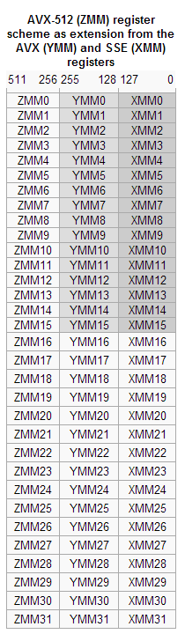
Intel AVX-512 (2013)
Introduce EVEX prefix
Extensions to 512 bits
New registers
New instructions
AVX-512 conflict detection (AVX-512CD) to help efficiently calculate conflict-free subsets of elements in loops that normally could not be safely vectorized.
Xeon Phi Knight’s Landing, Skylake-E

Slide 17
An Important Alternative
AltiVec is a floating point and integer SIMD instruction set designed and owned by Apple, IBM and Freescale Semiconductor
Implemented in the PowerPC and POWER
IBM updated it to VMX128 for the Xenon (Xbox 360)

Slide 18
Vectorization vs. SIMDization
Difference is in the length of the vector
SSE-type of SIMD, VL = 2 or 4
Related to cache line size
Vector supercomputers, VL = 128 or 256 or more
Related to memory bandwidth
SSE-type generally has more instructions to permute data

Slide 19
The most straightforward case
No loop dependences
Unit stride
Vectorization = Loop Distribution + Loop Unrolling

Slide 20
Distribute and Unroll
for (i=0; i<N; i++) { temp[i] = a[i] * b[i];
d[i] = temp[i] + c[i];
}
for (i=0; i<N; i++) { e[i] = d[i] + e[j-1];
}
for (i=0; i<N; i++) { d[i] = a[i] * b[i] + c[i];
}
for (i=0; i<N; i++) { e[i] = d[i] + e[j-1];
}
for (i=0; i<N; i++) { d[i] = a[i] * b[i] + c[i]; e[i] = d[i] + e[j-1];
}
Original
Loop Distribution
Simplify ops

Slide 21
Distribute and Unroll
for (i=0; i<N%4; i+=4) { temp[i] = a[i] * b[i];
d[i] = temp[i] + c[i]; temp[i+1] = a[i+1] * b[i+1];
d[i+1] = temp[i+1] + c[i+1];
temp[i+2] = a[i+2] * b[i+2];
d[i+2] = temp[i+2] + c[i+2]; temp[i+3] = a[i+3] * b[i+3];
d[i+3] = temp[i+3] + c[i+3];
}
for (; i<N; i++) { temp[i] = a[i] * b[i];
d[i] = temp[i] + c[i];
}
for (i=0; i<N; i++) { e[i] = d[i] + e[j-1];
}
for (i=0; i<N%4; i+=4) { temp[i] = a[i] * b[i];
temp[i+1] = a[i+1] * b[i+1];
temp[i+2] = a[i+2] * b[i+2];
temp[i+3] = a[i+3] * b[i+3];
d[i] = temp[i] + c[i];
d[i+1] = temp[i+1] + c[i+1];
d[i+2] = temp[i+2] + c[i+2]; d[i+3] = temp[i+3] + c[i+3];
}
for (; i<N; i++) { temp[i] = a[i] * b[i];
d[i] = temp[i] + c[i];
}
for (i=0; i<N; i++) { e[i] = d[i] + e[j-1];
}
for (i=0; i<N%4; i+=4) { temp[i:i+3] = a[i:i+3] * b[i:i+3];
d[i:i+3] = temp[i:i+3] + c[i:i+3];
}
for (; i<N; i++) { temp[i] = a[i] * b[i];
d[i] = temp[i] + c[i];
}
for (i=0; i<N; i++) { e[i] = d[i] + e[j-1];
}
Unroll
Group ops
Vectorize

Slide 22
The complications
Mis-alignment
Made worse by runtime alignment (i.e., alignment is not known at compile time, eg. 2-D array)
Non-unit stride
Many apps do not have unit strides

Slide 23
Peng Wu, Alexandre E. Eichenberger, and Amy Wang, “Efficient SIMD Code Generation for Runtime Alignment and Length Conversion”, Proceedings of the International Symposium on Code Generation and Optimization (CGO) 2005.
Views memory as streams of contiguous memory locations.

Slide 24
vload / vstore
Vector loads and stores must occur at certain boundaries (related with the cache).
Example: assume 16-byte boundaries, and array a has a[0] starting at such a boundary. Then:
V1 = vload(a[2])
will load the elements a[0], a[1], a[2], and a[3] (i.e. the 16-byte block containing a[2]) into V1.

Slide 25
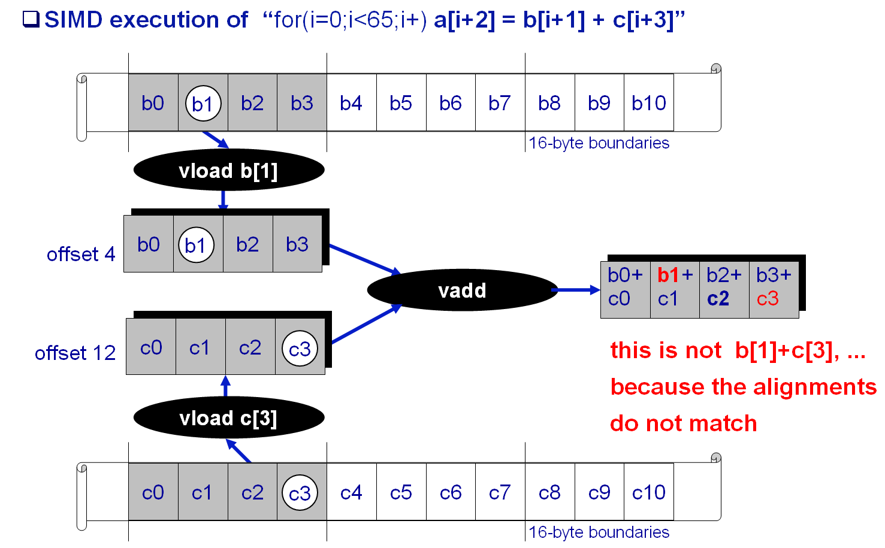
SIMD Alignment Problem
Notes:
Alignment matters in register too.
consider now the addition. First we load both b and c. You see that the b[1] and c[2] data are in the register at different offsets

Slide 26
Three Policies
Zero-Shift Policy.
Shifts each misaligned load stream to offset zero
Shifts the store stream from offset zero to the alignment of the store address
Eager-Shift Policy.
Shifts each load stream directly to the alignment of the store.
Lazy-Shift Policy.
Pushes the shift towards the root of the expression tree as close as possible.
Only for certain kinds of loops
The shifts are
virtual! Need to
implement them
using real
instructions!

Slide 27
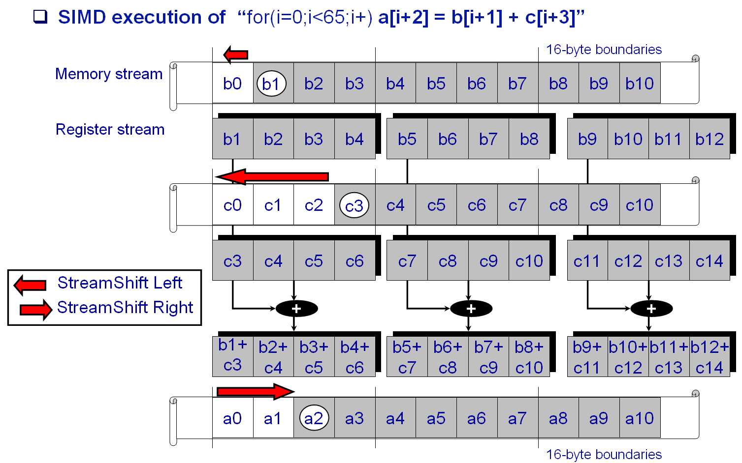
Loop-Level Simdization, Naïve Way
Notes:
My goal is to walk through a simple example to illustrate what are the issues when programming for a SIMD unit like the VMC
single loop with 3 memory streams: A written into, B and C read
focusing on the first iteration, (grey boxes), ops to compute this simple add

Slide 28
Solving the Alignment Problem
vload b[i+1]
vload c[i+3]
offset 4
offset 12
Data Reorganization Graph
original graph with alignment label each load/store
resolve alignment conflicts
vadd
conflict:
reaching alignments
are not all identical
vstore a[i+2]
offset 8

Slide 29
Solving the Alignment Problem
offset 4
offset 12
Data Reorganization Graph
original graph with alignment label each load/store
resolve alignment conflicts by adding “stream-shift” aligning operations
vload b[i+1]
vload c[i+3]
stream-shift(4,0)
stream-shift(12,0)
offset 0
vadd
From offet
To offset
stream-shift(0,8)
set alignment
of streams
to zero
vstore a[i+2]
offset 8

Slide 30
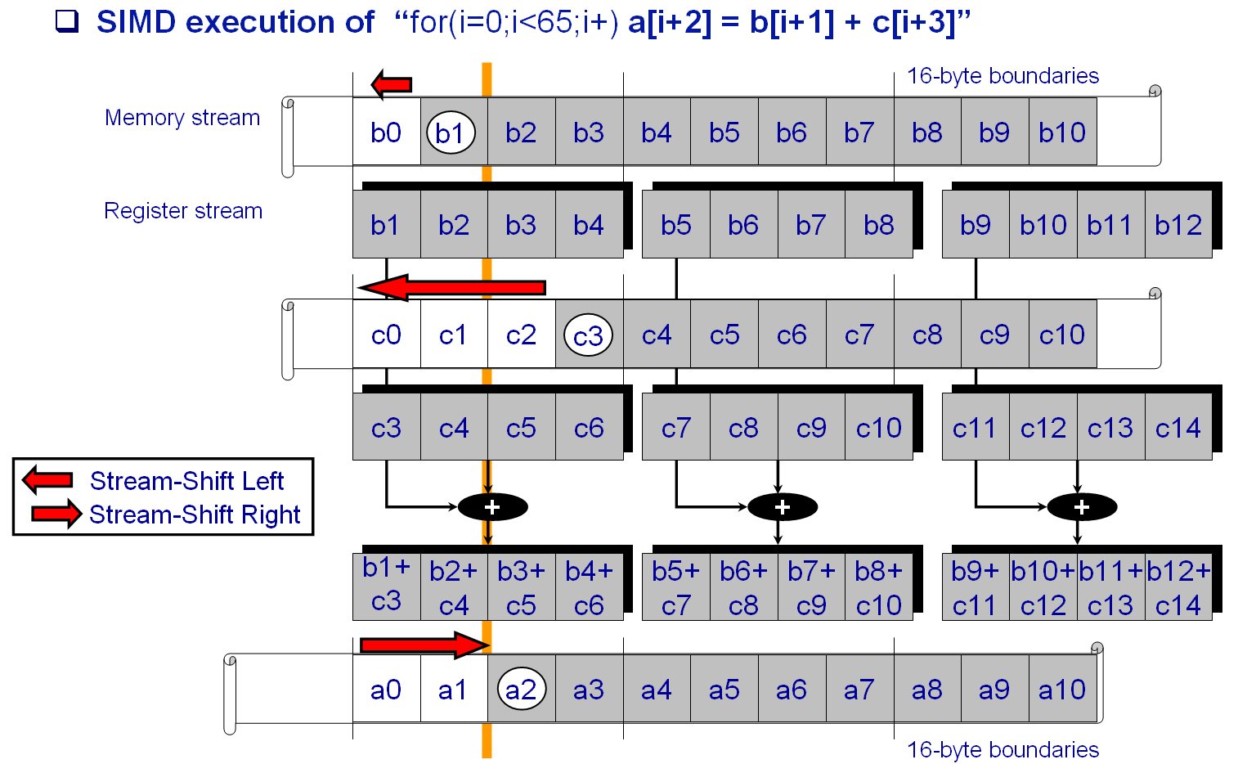
Loop-Level Simdization, Optimized Way
Notes:
My goal is to walk through a simple example to illustrate what are the issues when programming for a SIMD unit like the VMC
single loop with 3 memory streams: A written into, B and C read
focusing on the first iteration, (grey boxes), ops to compute this simple add

Slide 31
Optimized Solving of the Alignment Problem, Eager Policy
Data Reorganization Graph
eagerly align to store alignment
V1 = b[i+1:i+4]
V2 = c[i+3:i+6]
offset 4
offset 12
stream-shift(4,8)
stream-shift(12,8)
V3 = V1 + V2
set to store alignment;
reduce stream-shift #
from 3 to 2
a[i+2:i+5] = V3
offset 8

Slide 32
Optimized Solving of the Alignment Problem, Lazy Policy
Data Reorganization Graph (slightly different “b[i+1] + c[i+1]” example)
lazily align to store alignment
vload b[i+1]
vload c[i+1]
offset 4
offset 4
vadd
stream-shift(4,8)
lazily set to store align;
reduce stream-shift #
from 3 to 1
vstore a[i+2]
offset 8

Slide 33
The spoiler
The above requires knowledge about the alignment at compile time
To shift from x to y, must use
Right shift if x ≤ y
Left shift if x ≥ y
Zero shift policy can always be used
Shifts are from x to 0, or 0 to y
Less optimized

Slide 34
A solution
Need a way to compute the shifts needed
Always use one (left) shift that can achieve the any shift amount
Insight: instead of looking at where the first element of the original array end up, look at what the first vector register element should come from

Slide 35
vperm
vperm(v₁, v₂, k) selects bytes k, k + 1, …, k + V − 1 from a double-length vector constructed by concatenating v₁ and v₂, where V is the vector length
It is a “virtual” instruction that needs to be mapped to real SIMD processor instruction

Slide 36
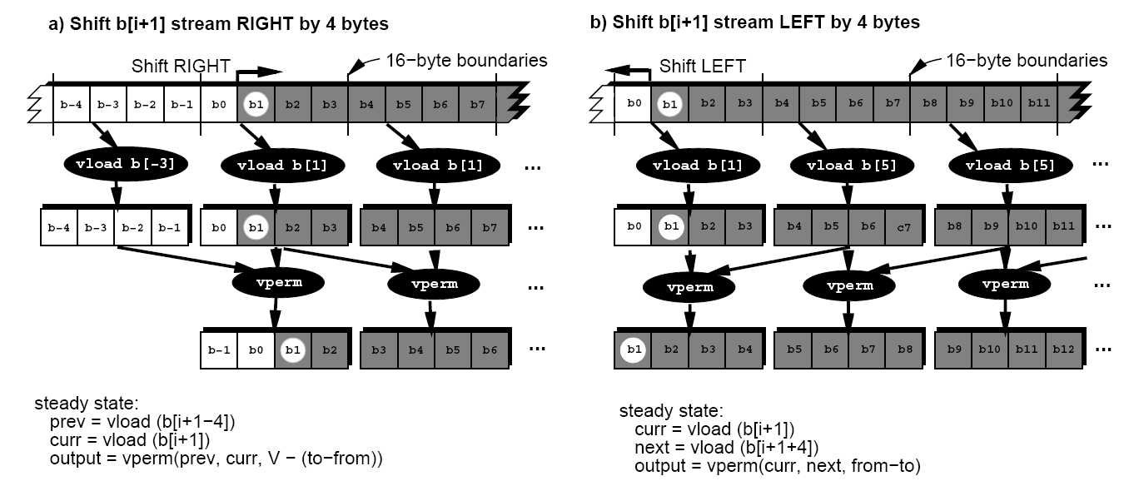
Implementing the shifts

Slide 37
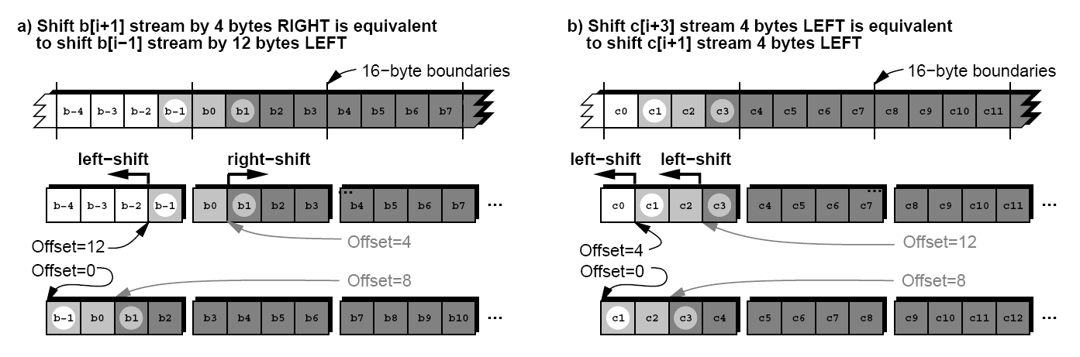
Left shift only

Slide 38
Prepend
Prepend_{W}(S, x) denotes prepending x bytes to the beginning of a stream S of W-byte wide registers.
Note that, the W associated with prepend is a free variable that can be set to any value.
It is used to convert lengths.
If not used as such, W = V.
Skip_{W} is the inverse of Prepend_{W}.

Slide 39

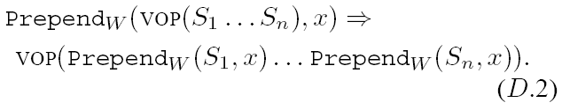
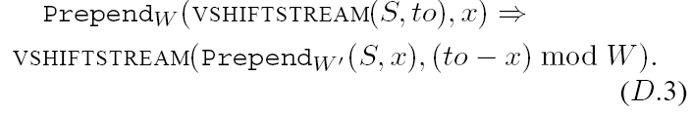
Prepend

Slide 40
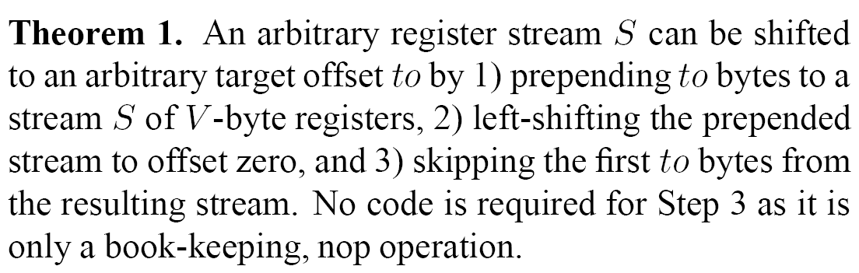
Theorem

Slide 41
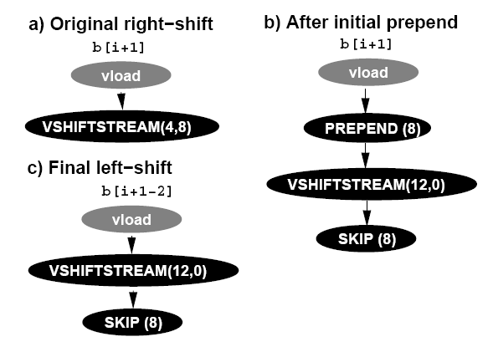
An Example

Slide 42
Another problem: Length conversion
In SIMD, it may be necessary to convert between data types of different lengths
Example, in other to add a byte with a 4-byte word, the former needs to be length converted to 4 bytes
Note that the byte comes from a byte array

Slide 43
VPACK and VUNPACK
VPACK(S, f) – packs a stream S by a factor f
VUNPACK(S, f) – unpacks a stream S by a factor f

Slide 44
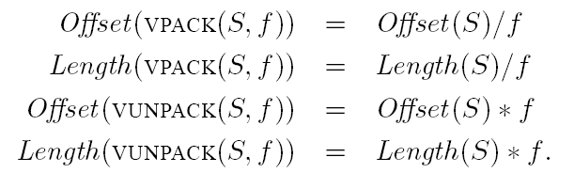
Offsets and lengths

Slide 45


Relationship with Prepend

Slide 46
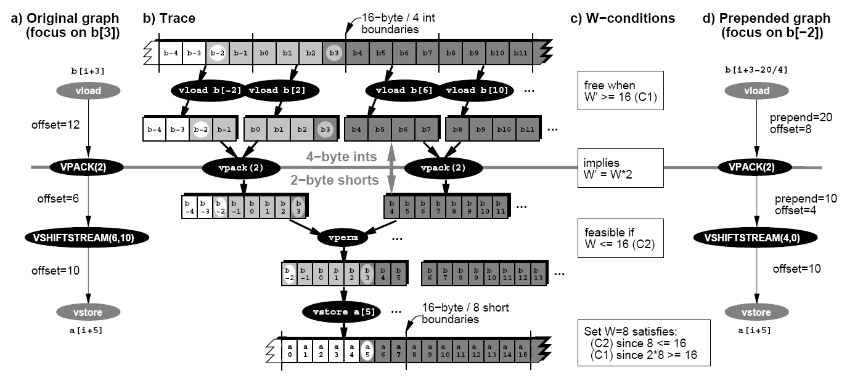
Length conversion example
a is an array of short, b is an array of int. a[i+5] = (short)b[i+3]

Slide 47
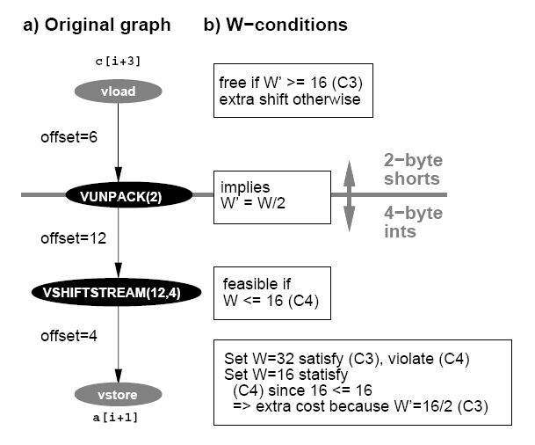
Another example
a is an array of int, c is an array of short. a[i+1] = (int)c[i+3]

Slide 48
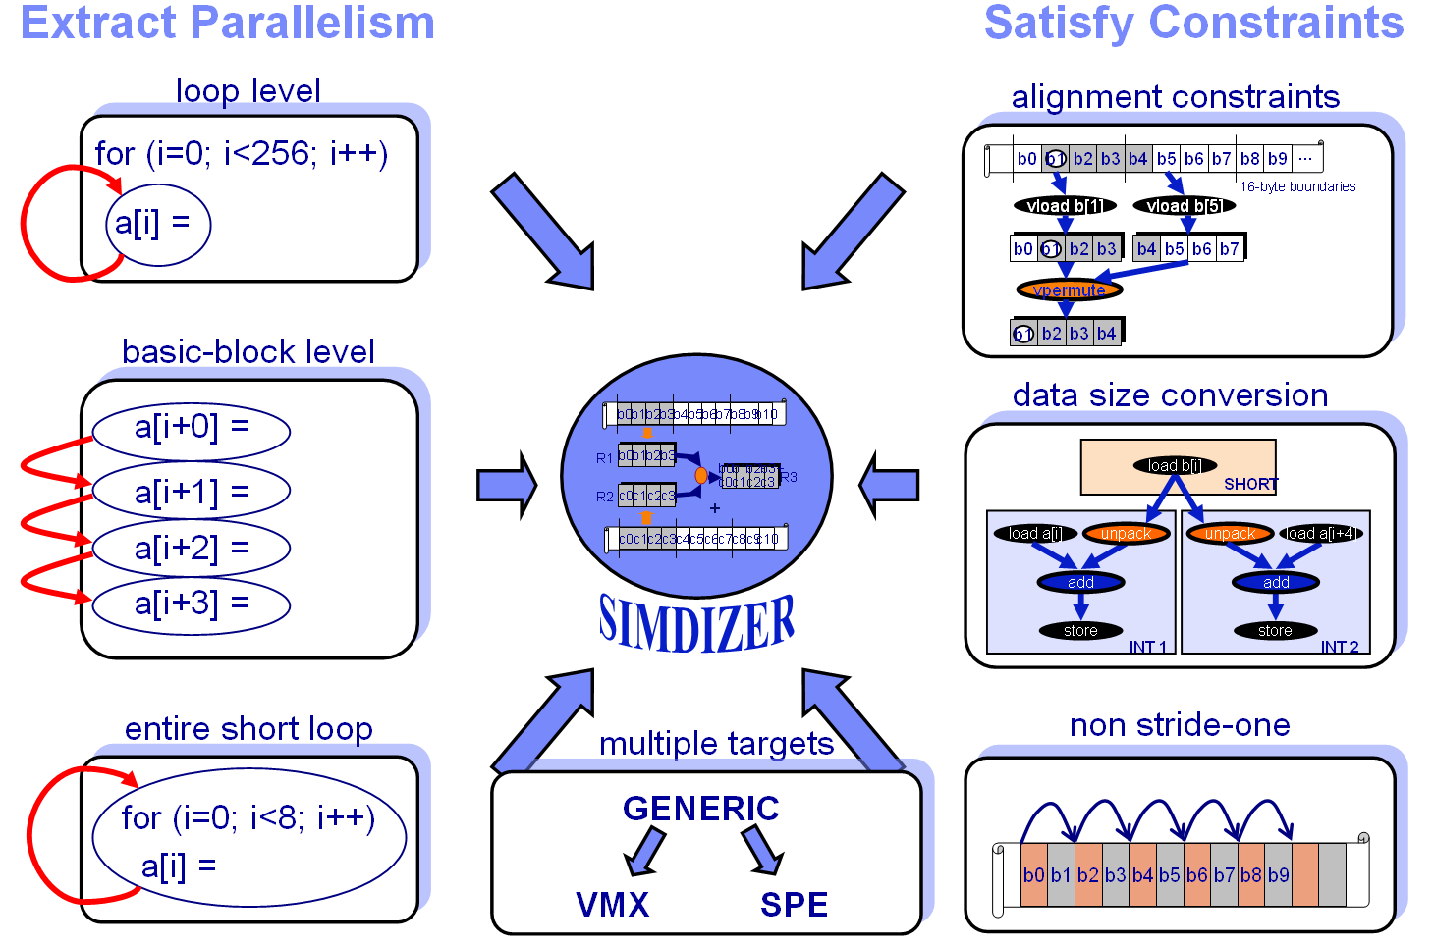
The IBM Cell SIMDizer Framework

Slide 49
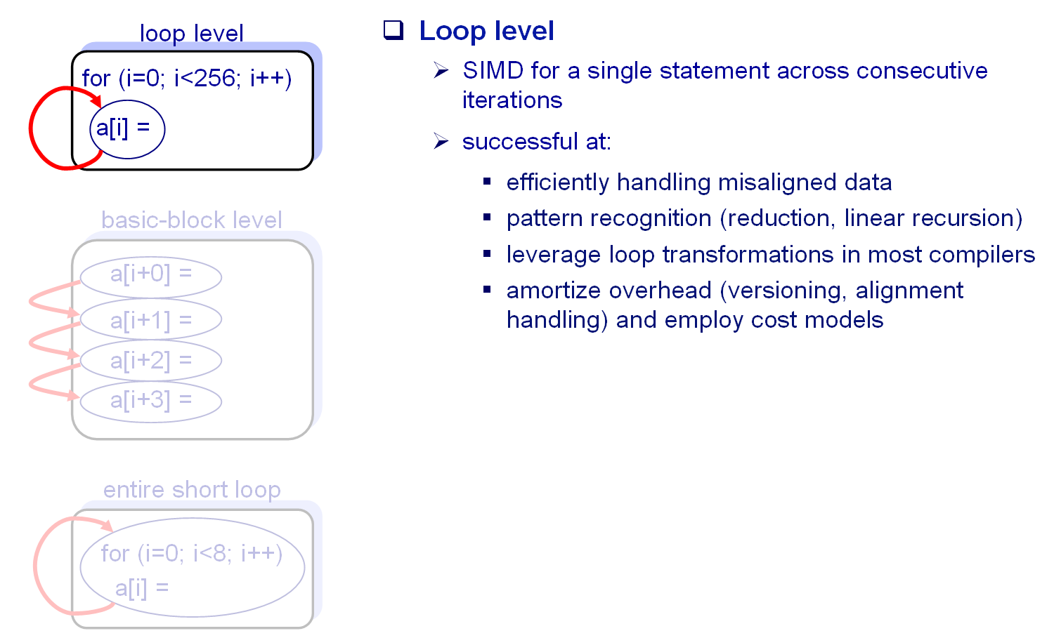
Loop Level Parallelism

Slide 50
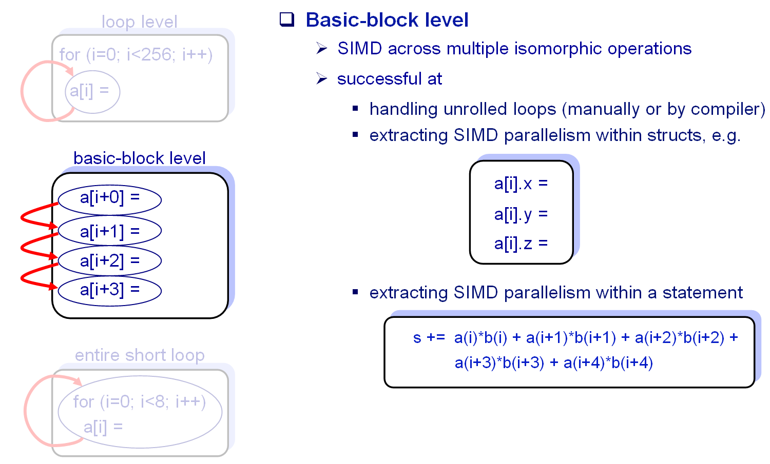
Basic Block Level Parallelism

Slide 51
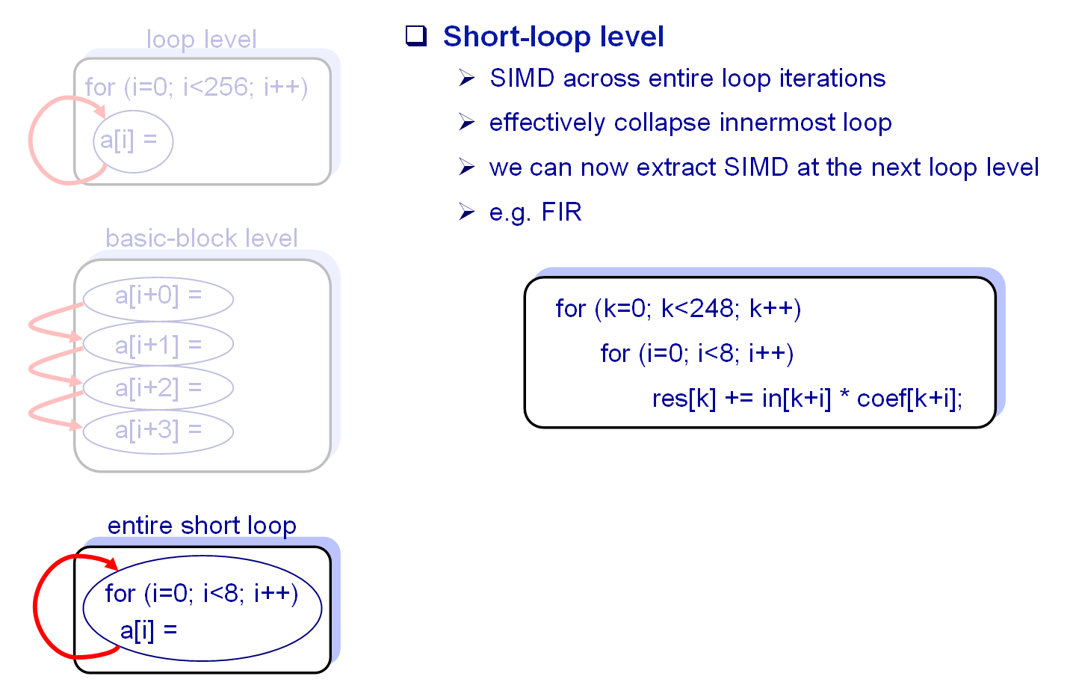
Entire Loop Parallelism

Slide 52
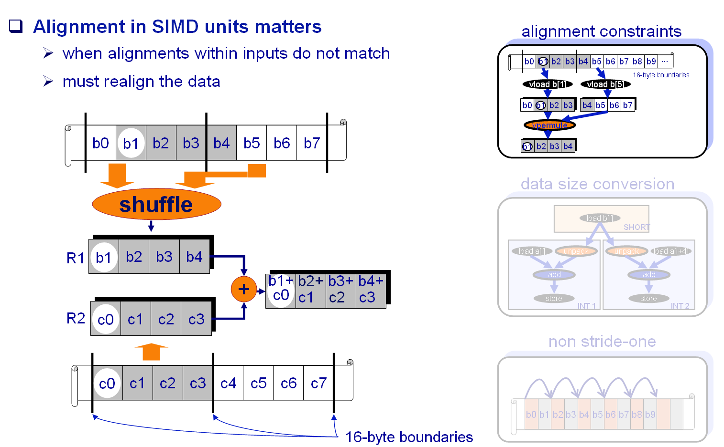
Alignment!

Slide 53
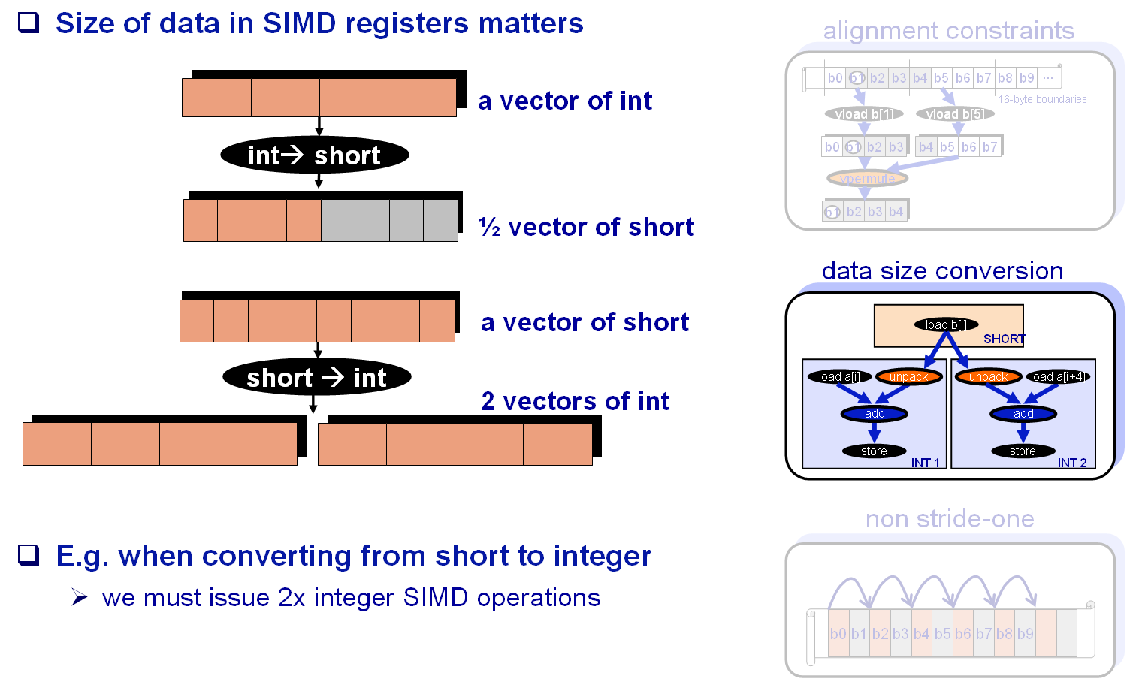
Size conversion

Slide 54
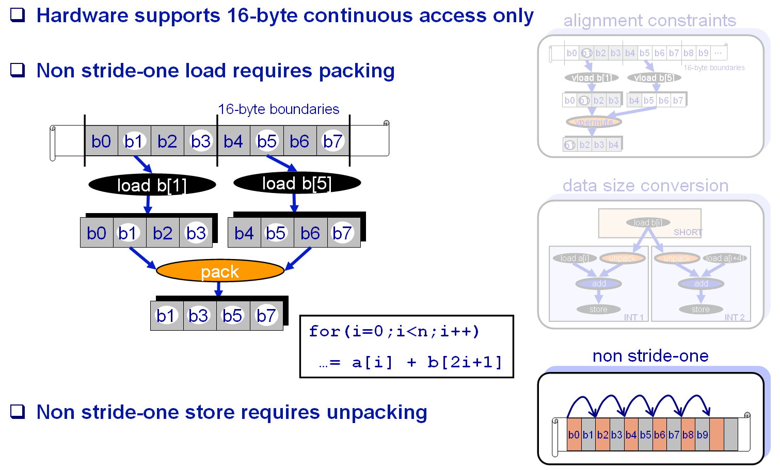
Non-unit Stride

Slide 55
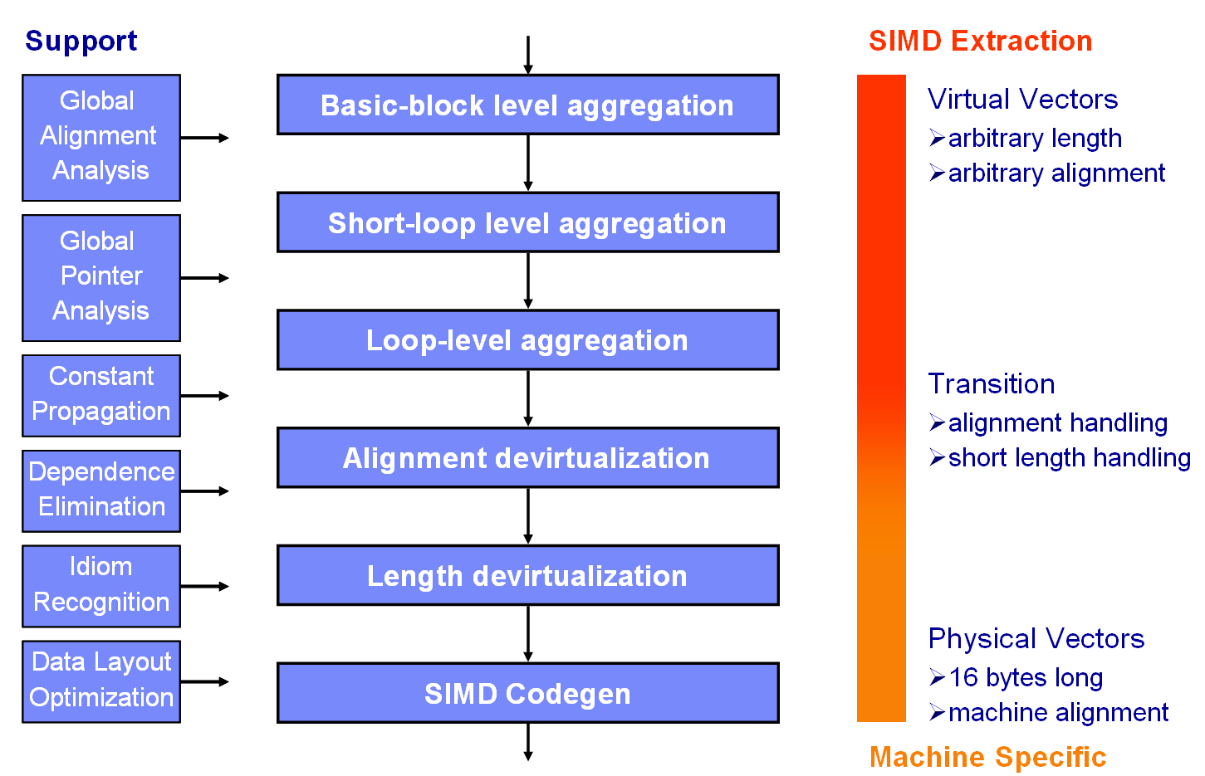
Integrated Framework

Slide 56
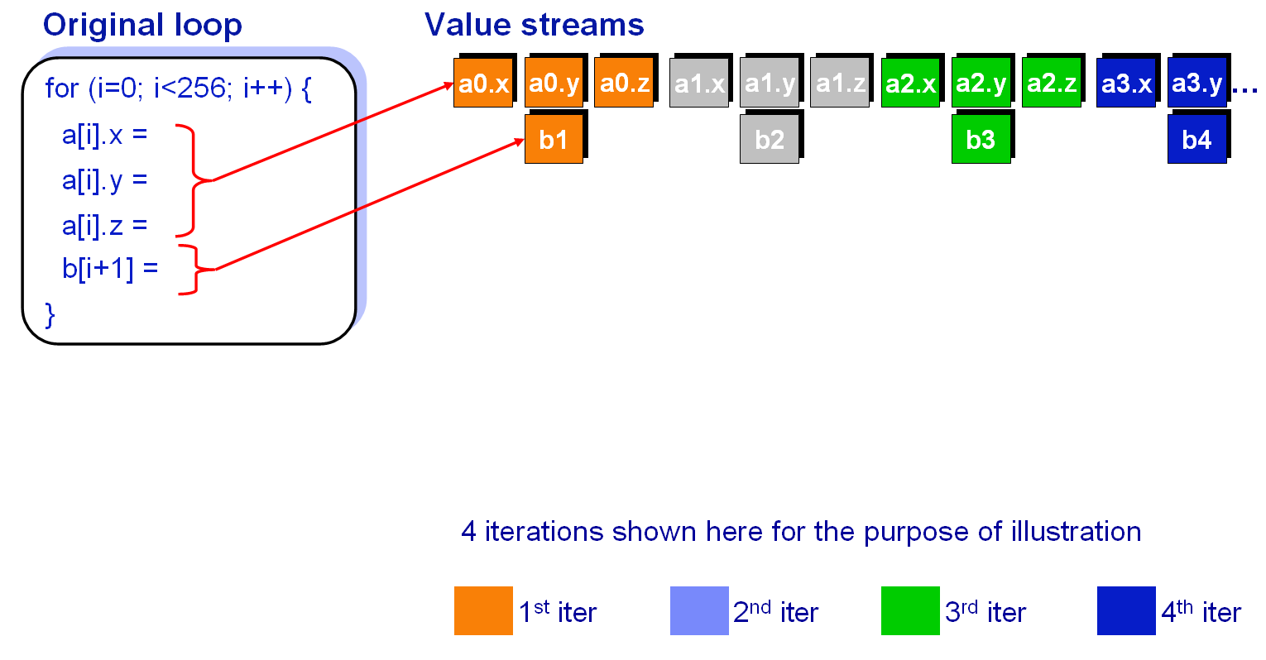
First Example

Slide 57
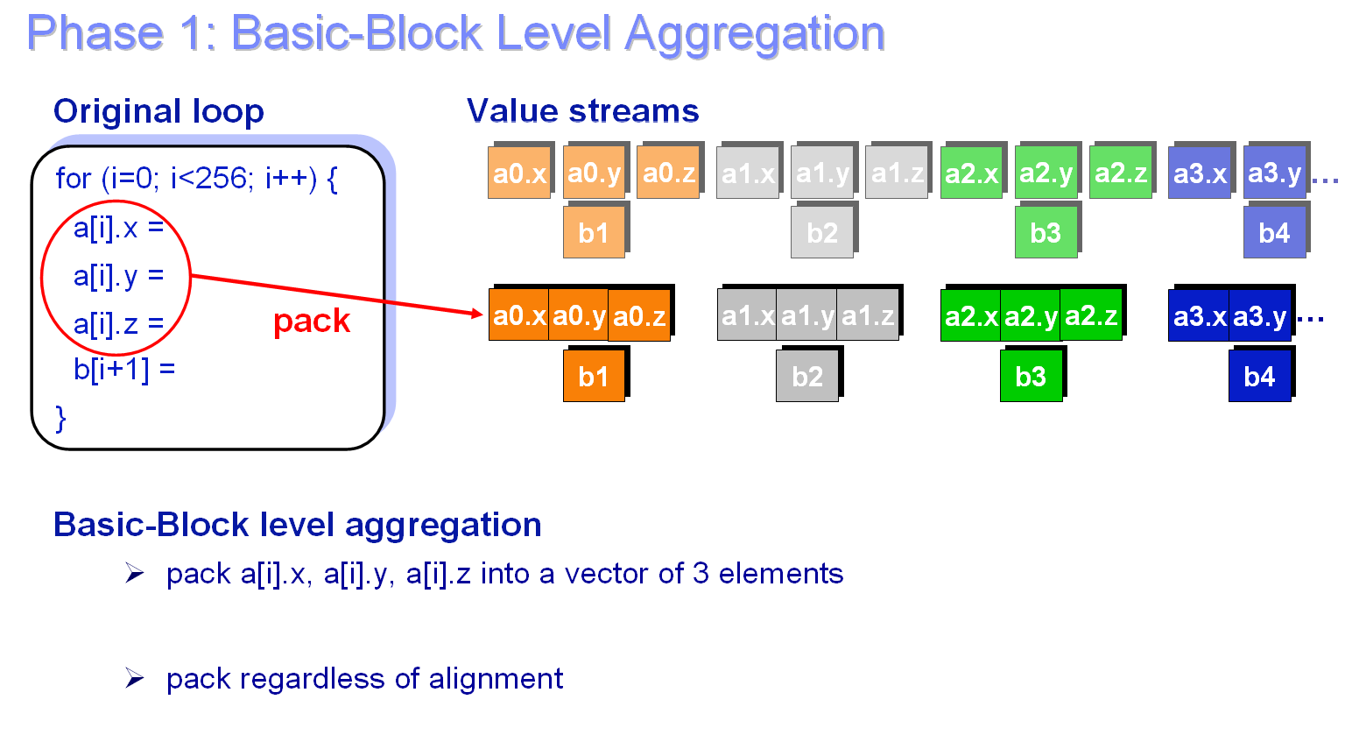
First Example

Slide 58
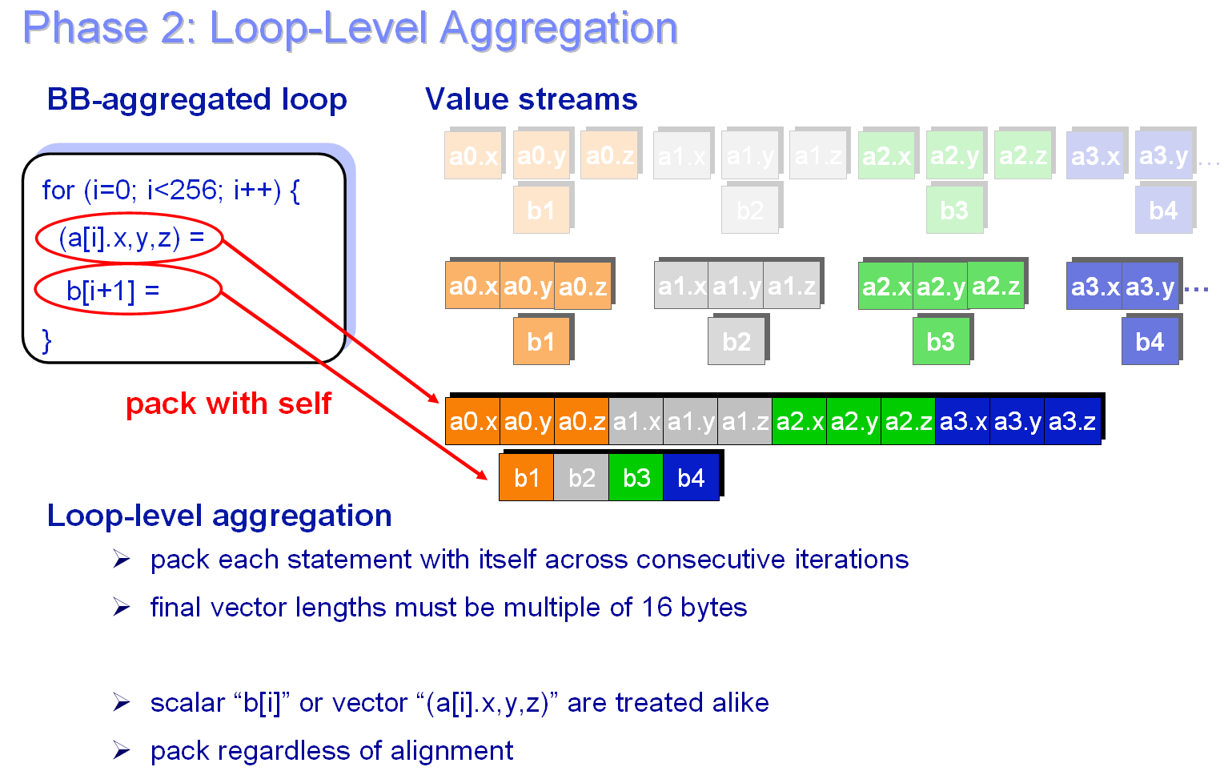
First Example

Slide 59
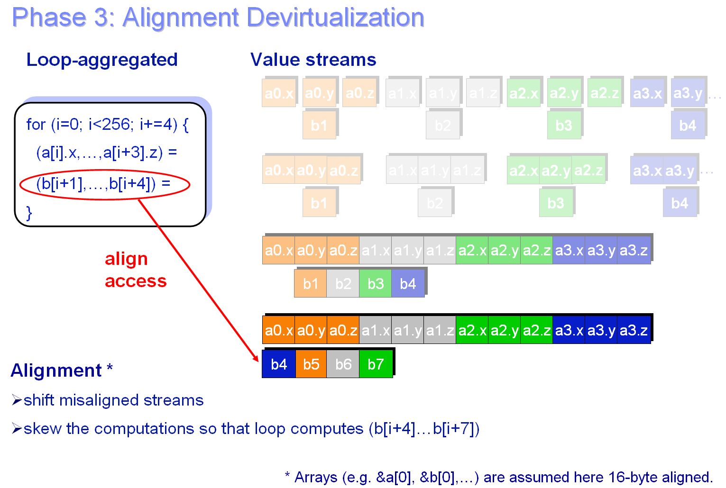
First Example

Slide 60
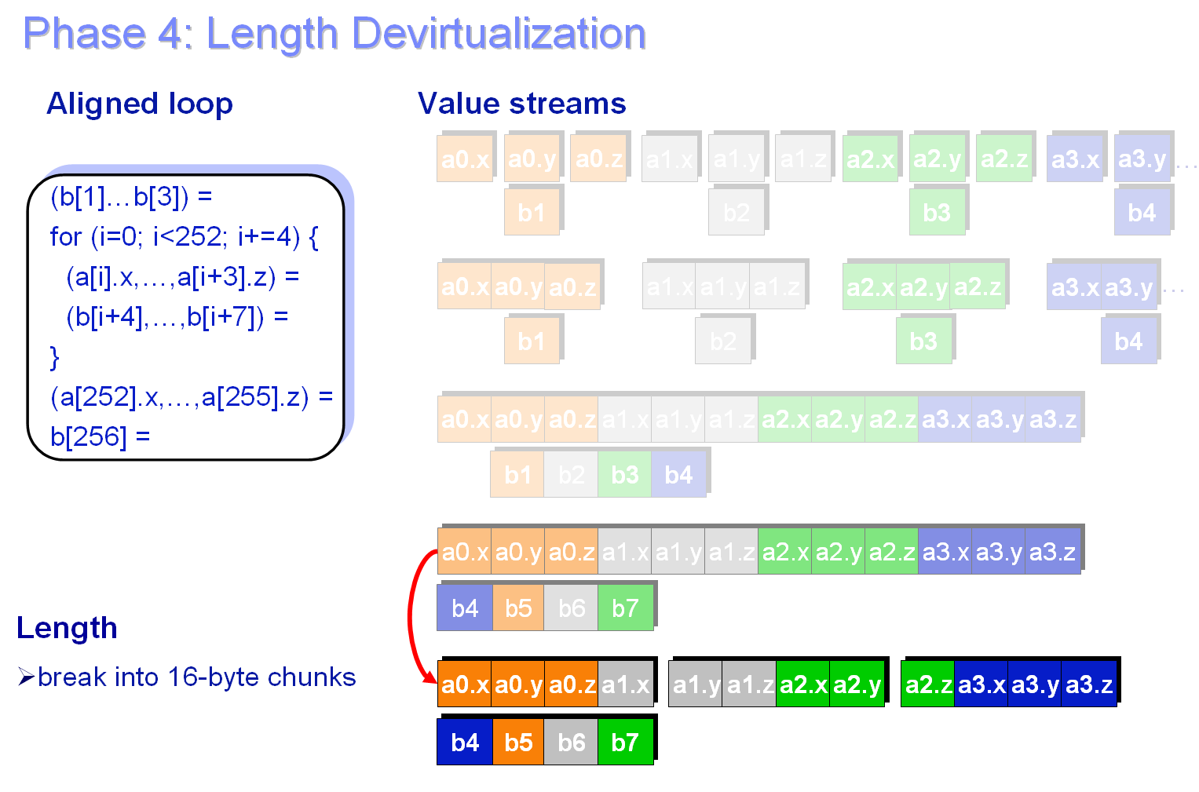
First Example

Slide 61
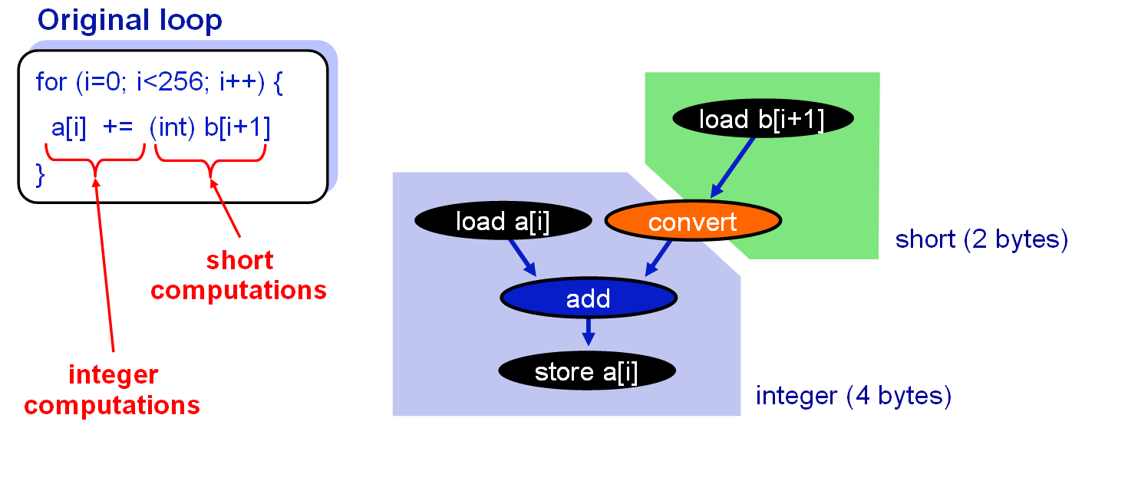
Second Example

Slide 62
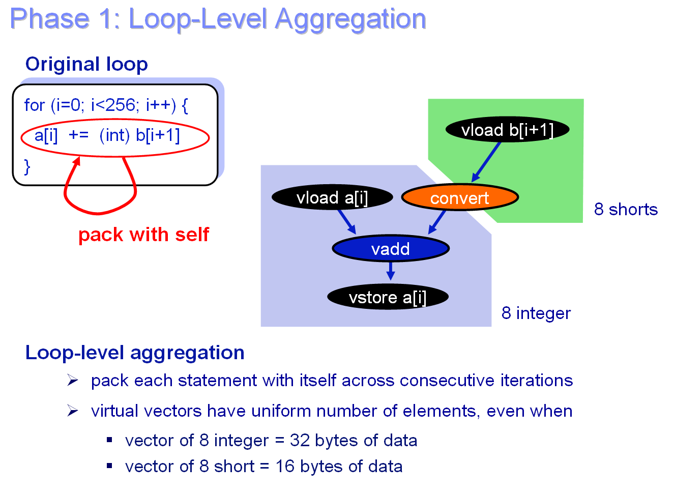
Second Example

Slide 63
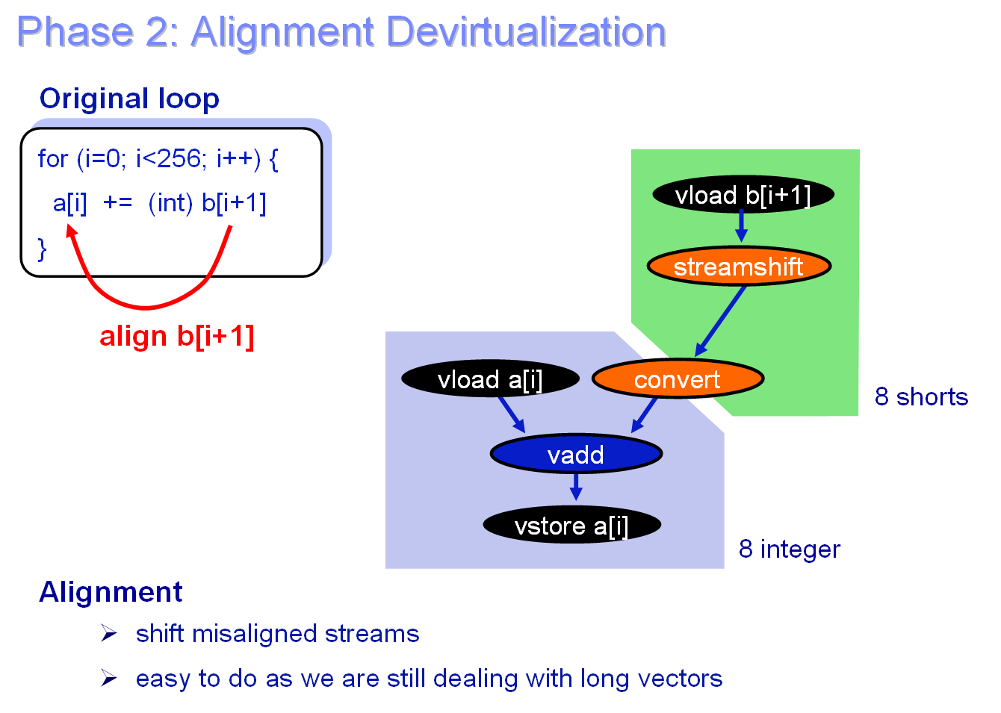
Second Example

Slide 64
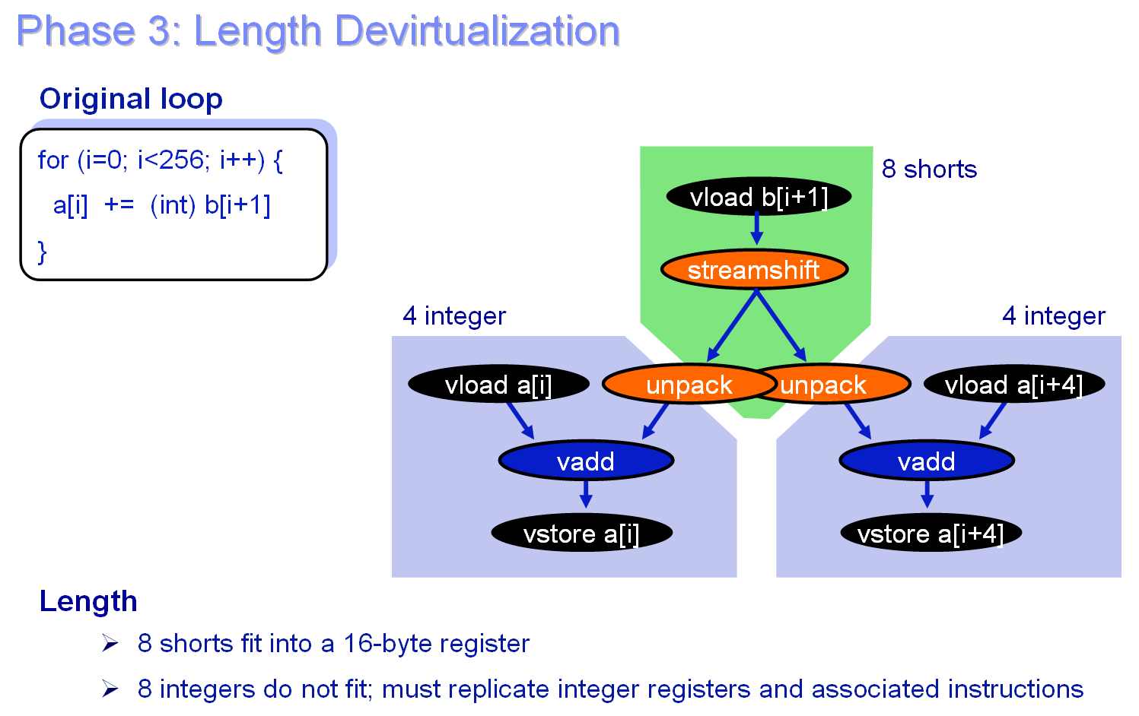
Second Example

Slide 65
End

